Slide 1

FIFA 2026 Winners
By: Sahar Karimi

Slide 2

Introduction
The FIFA Club World Cup is an annual international football competition featuring top club teams from each continent, and to determine the world’s best club team. The winning team takes home a golden trophy

Slide 3
Purpose
The purpose of this project is to predict which team is most likely to win the 2026 FIFA World Cup using real match data.
This project:
Helps soccer fans understand team strength
Helps us understand how data and Python can make real predictions
Gives people an easy way to compare teams instead of guessing
Why I thought of this idea
I enjoy soccer, and I wanted a fun project that would also teach me important software engineering skills, such as data analysis, data cleaning, prediction logic, and system design skills.

Slide 4
Problem Definition & Stakeholders
Who has a stake in this solution?
Soccer fans who want to know how strong teams really are.
Sports analysts looking for data patterns.
Sports bettors who bet on winning team.
Data scientists/researchers working on predictive models
Some Unknowns in the Problem
New players joining before 2026
Injuries that change team performance
Why the problem can be solved with software
Match outcomes can be measured.
Wins and win rates can be calculated.
Patterns can be represented in charts, tables, and flow diagrams

Slide 5




Frameworks
-Jupyter Notebook
- Python
- Kaggle
-Github
-Vscode

Slide 6
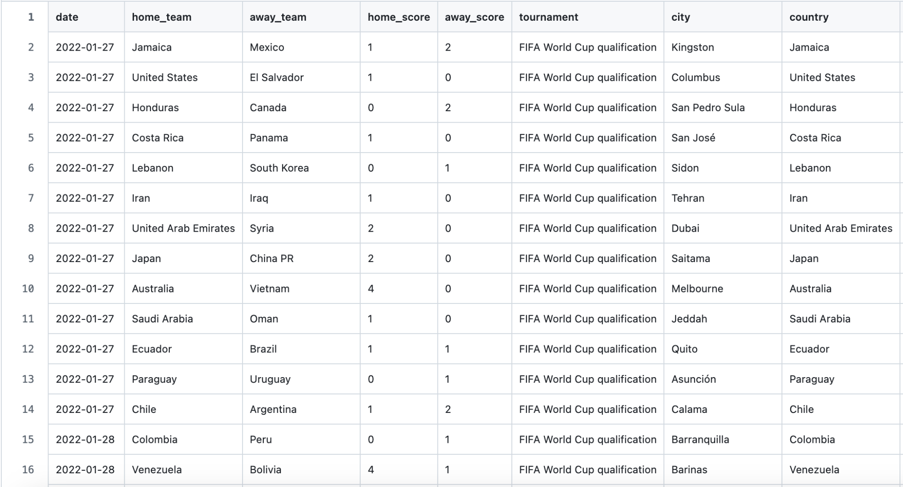
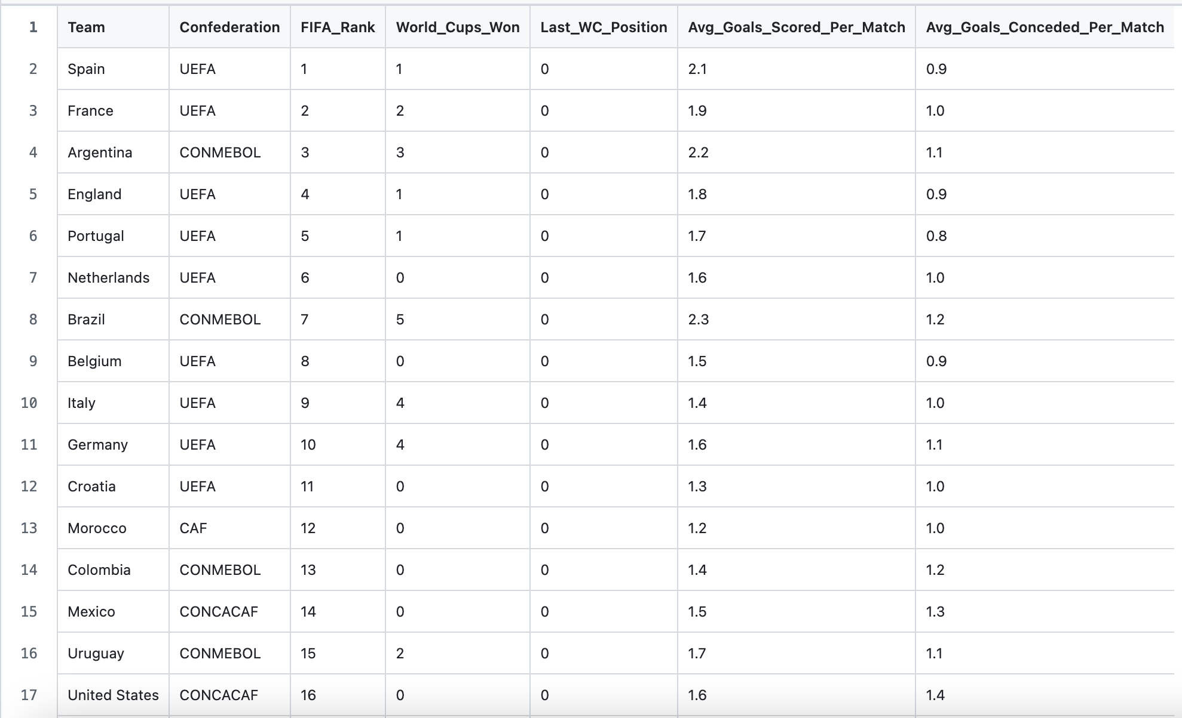
Data Set Information
worldcup_predictor_teams.csv
recent_wc_matches.csv

Slide 7
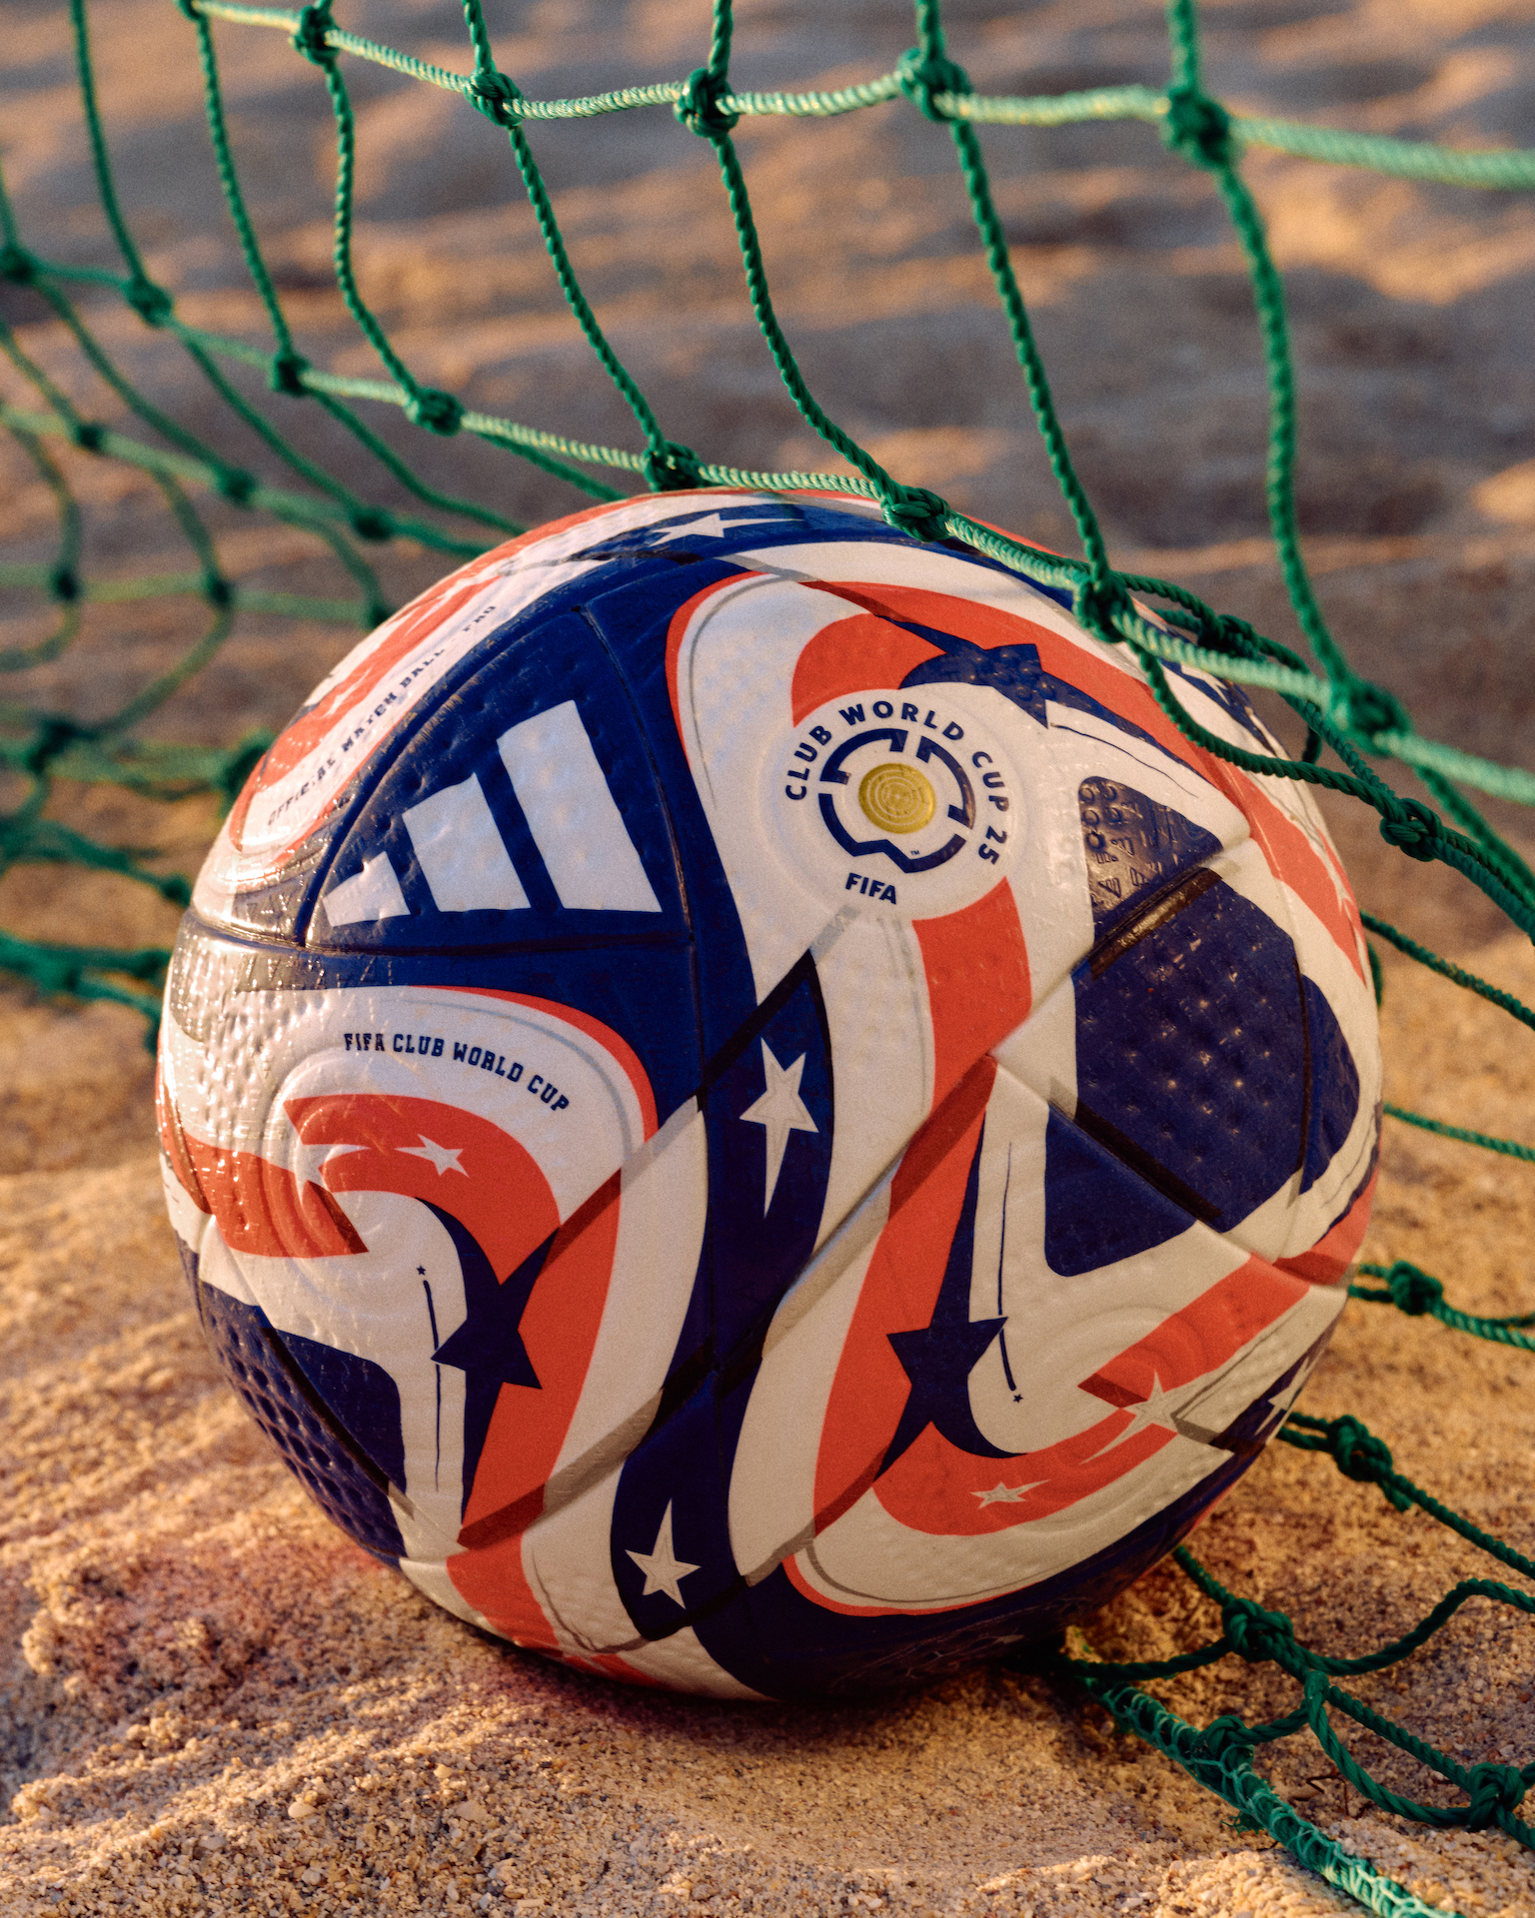
System Design
Load the dataset - recent_wc_matches.csv - worldcup_predictor_teams.csv
Clean Data - Remove spaces - Convert team names
Analyze team performance
Count team wins
Count total matches played
Calculate win rate = wins ÷ matches
Rank teams
Highest win rate = strongest team
Count total matches played
Calculate win rate = wins ÷ matches
5.) Winners
Team with the highest win rate becomes the predicted 2026 winner
Results After Program Runs predictions_2026.csv predictions_2026_full.csv

Slide 8
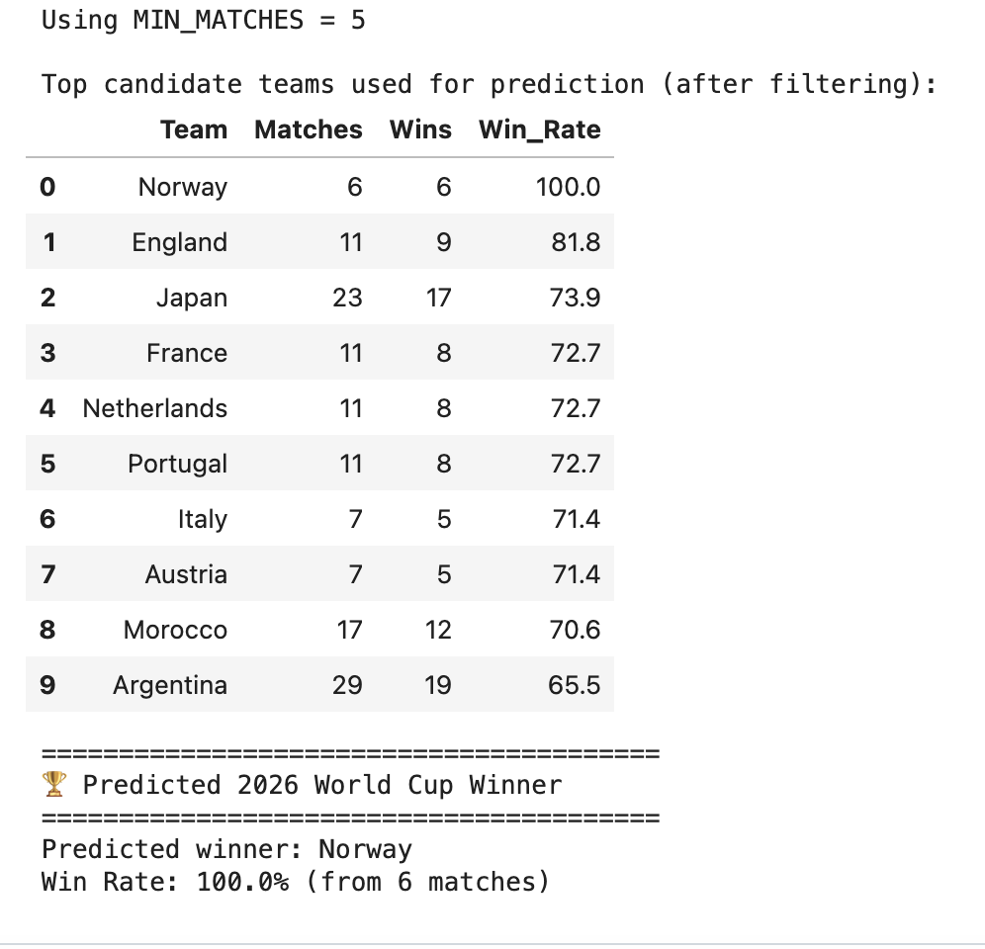
Final Predictions
A ranked list of all 2026 World Cup teams
Their total wins
Total matches played
Calculated win rate
Final predicted winner
Why this matters
-Demonstrates how real world systems make predictions. - Shows practical use of Python, data processing, and software engineering principles.

Slide 9


Link To Github: https://github.com/Sahaar34/CS401-Project

Slide 10
Sources:
https://github.com/yassinelar/Fifa-22-data-analysis
https://www.youtube.com/watch?v=anEoBZkZRHA
https://chatgpt.com

